Slide 1
Parts of Speech
All About
Interjections

Slide 2
Interjections
An interjection is an abrupt remark or exclamation that is made as an aside or interruption.
Interjections may be words or phrases.
Think of the interjection as an emotion or reaction inserted into a sentence.

Slide 3
Interjections
Commonly Used Interjections
Interjections are words that
convey emotion or show sound.
oh | hello | ah | oops | darn
aha | yes | hey | hooray | cheers
ahem | no | shoo | uh-oh | bravo
shh | hey | yikes | ouch | whoa
hmm | wow | oh my | phew | boo
gee wiz | eh | oh well | good grief | holy cow

Slide 4
Interjections
Interjections are common in everyday language and informal writing.
Interjections are usually found in dialogue.
Interjections are not usually found in formal academic writing.

Slide 5
Interjections
Usually, interjections are punctuated with an exclamation point and are set off separately from the rest of the sentence.
Example:
Wow! Look what I did.
Hey! Stop copying my answer.
!

Slide 6
Interjections
As a rule of thumb, you will want to use interjections sparingly. If you overuse interjections in your writing, they will lose their effect.

Slide 7
Interjections
Some show sound
Some show emotion
Awww!
Yippee!
Hmmmm
Ugh
Hah
Whoa
Um
Psst
Hooray!
Yay!
Awesome!
Yuck!
Yikes!
Holy moly!
Hey!
Oh no!
Oh well!

Slide 8
Interjections
Interjections can found at the beginning of, or before, a sentence.
Examples:
Wow! This candy is really sour.
Well, I think I want the red shoes.
Ouch! That hurt.
Hmm, I don’t really know.
Oh, snap! I forgot my mom’s birthday.
Oh, I never heard of that before.

Slide 9
Interjections
Interjections can found at the end of a sentence.
Examples:
You won the race, congratulations!
I just found the missing piece, phew.
I think I just broke this device, oops.
The baby is sleeping, shh.

Slide 10
Interjections
Now it’s your turn to write with interjections! On the next slides, use the interjections in the table to complete each sentence or phrase.
?

Slide 11
Interjections
___________, I don’t know about that.
___________! You look nice in that dress.
___________! Get out of here.
___________! I stubbed my little toe.
hey | hmm | ouch | wow
Hmm
Wow
Hey
Ouch

Slide 12
Interjections
___________! We didn’t get caught.
___________! Get out of here, fly.
___________! The theater closed already.
___________! I think I forgot my homework.
oh-well | phew | shoo | uh-oh
Phew
Shoo
Oh-well
Uh-oh

Slide 13
Interjections
We are in the library, ___________.
I won my race, ___________!
This sushi is gross, ___________!
We forgot to lock the house, _________.
hooray | oops | shh | yuck
shh
hooray
yuck
oops

Slide 14
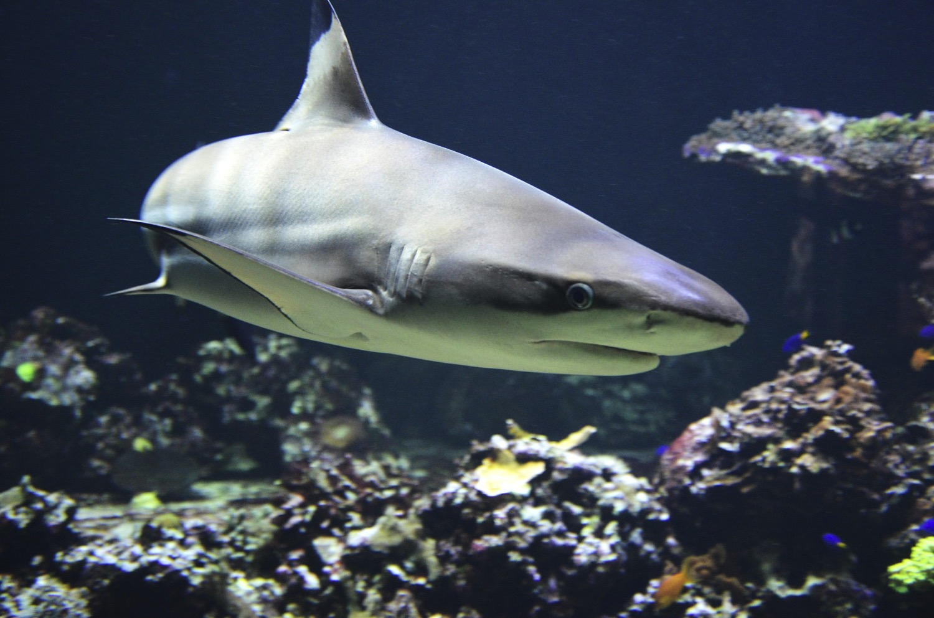
Write with Interjections
Using the picture as a prompt, write a sentence that includes an interjection.

Slide 15

Write with Interjections
Using the picture as a prompt, write a sentence that includes an interjection.

Slide 16
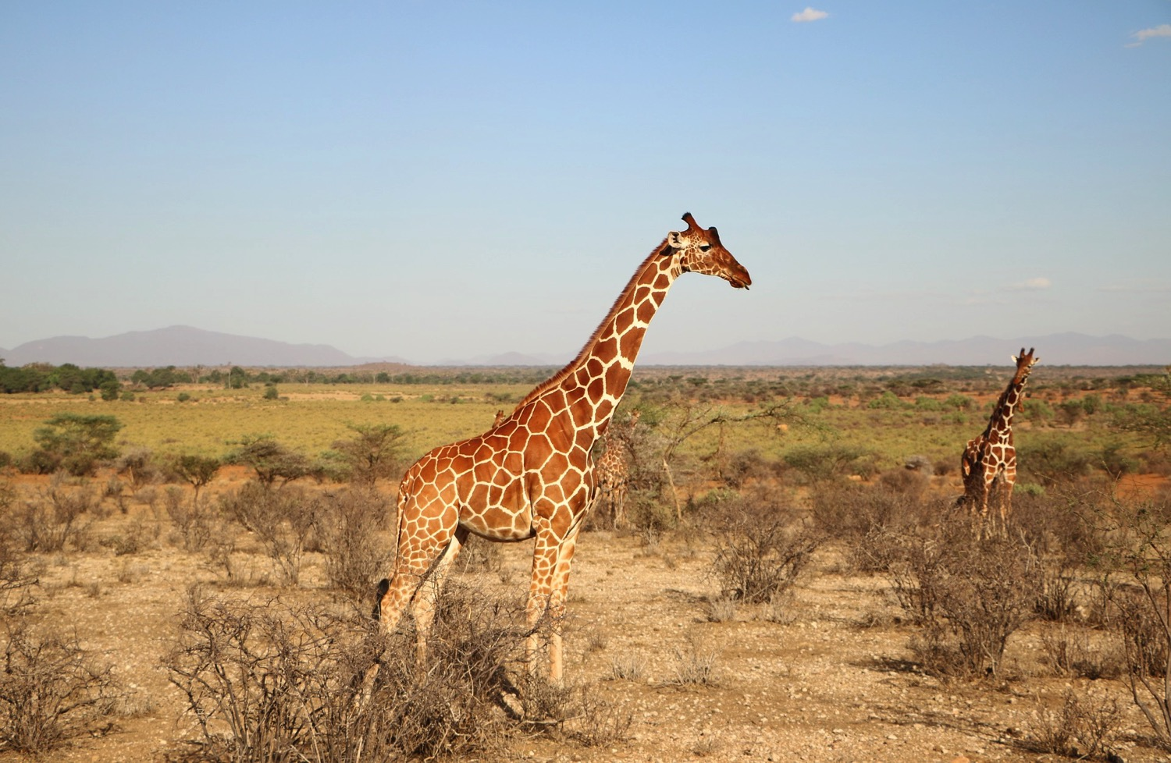
Write with Interjections
Using the picture as a prompt, write a sentence that includes an interjection.

